Slide 1


Slide 2


Slide 3
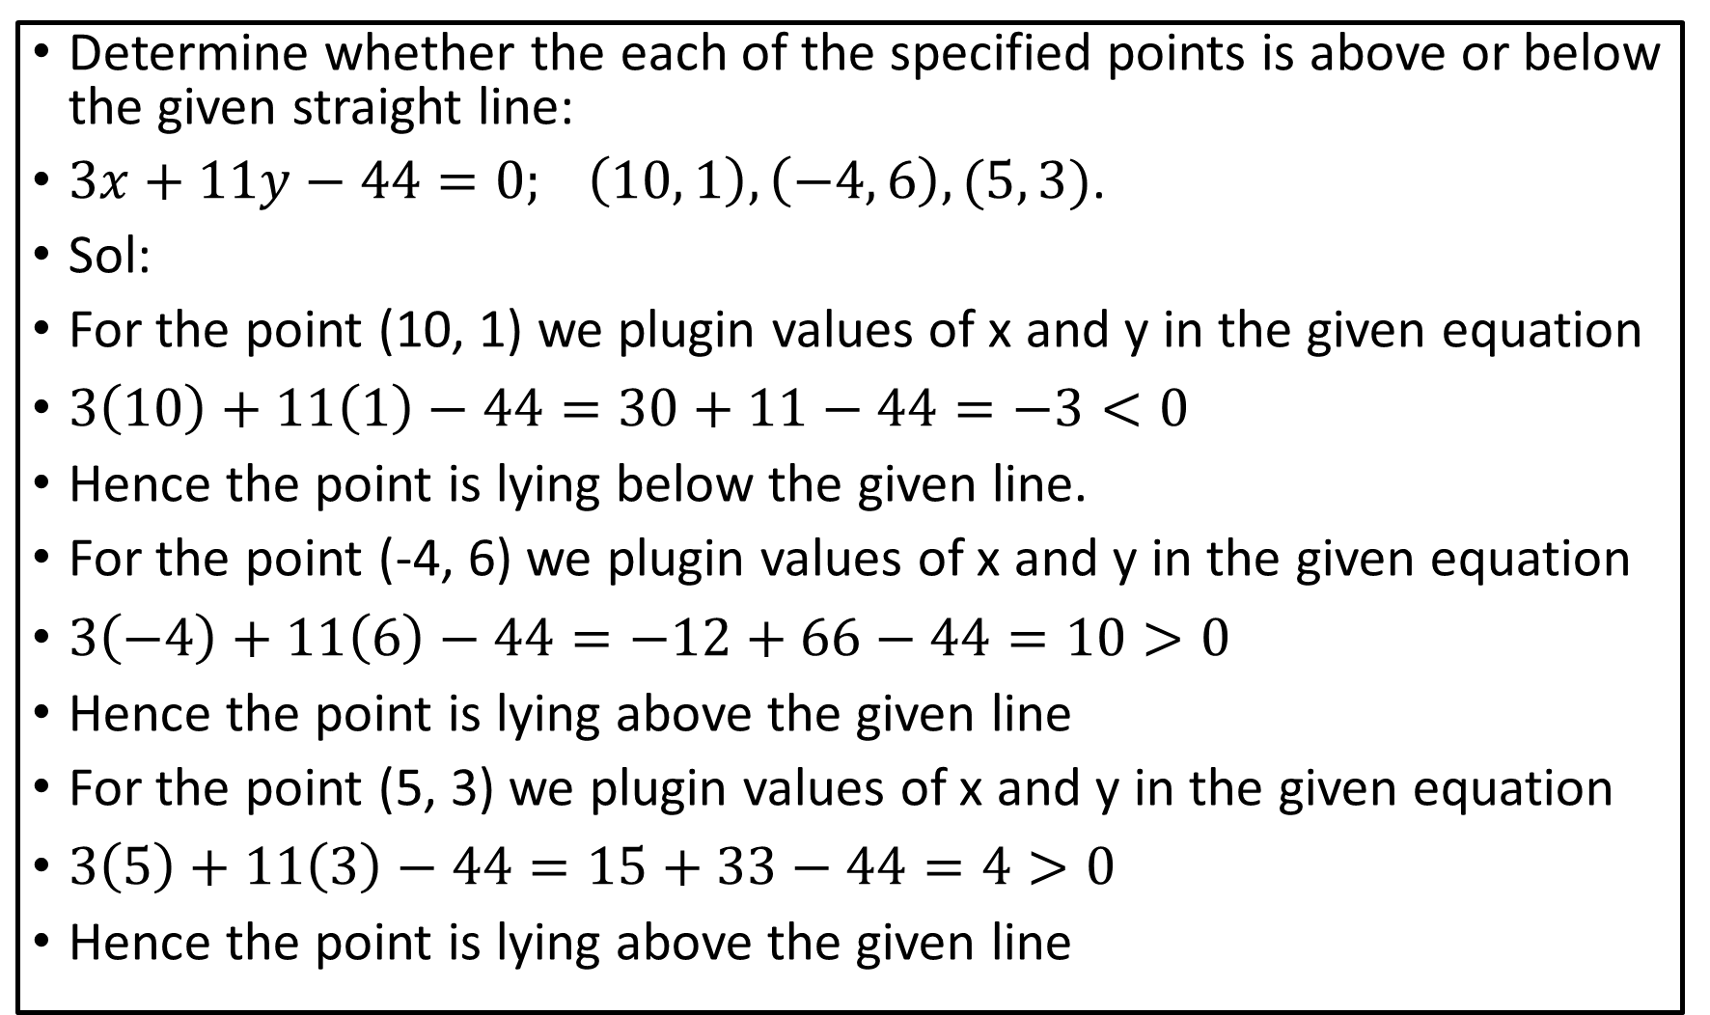
Determine whether the each of the specified points is above or below the given straight line:
$3x+11y−44=0; \left(10, 1\right), \left(−4, 6\right), (5, 3)$.
Sol:
For the point (10, 1) we plugin values of x and y in the given equation
$3\left(10\right)+11\left(1\right)−44=30+11−44=−3<0$
Hence the point is lying below the given line.
For the point (-4, 6) we plugin values of x and y in the given equation
$3\left(−4\right)+11\left(6\right)−44=−12+66−44=10>0$
Hence the point is lying above the given line
For the point (5, 3) we plugin values of x and y in the given equation
$3\left(5\right)+11\left(3\right)−44=15+33−44=4>0$
Hence the point is lying above the given line

Slide 4
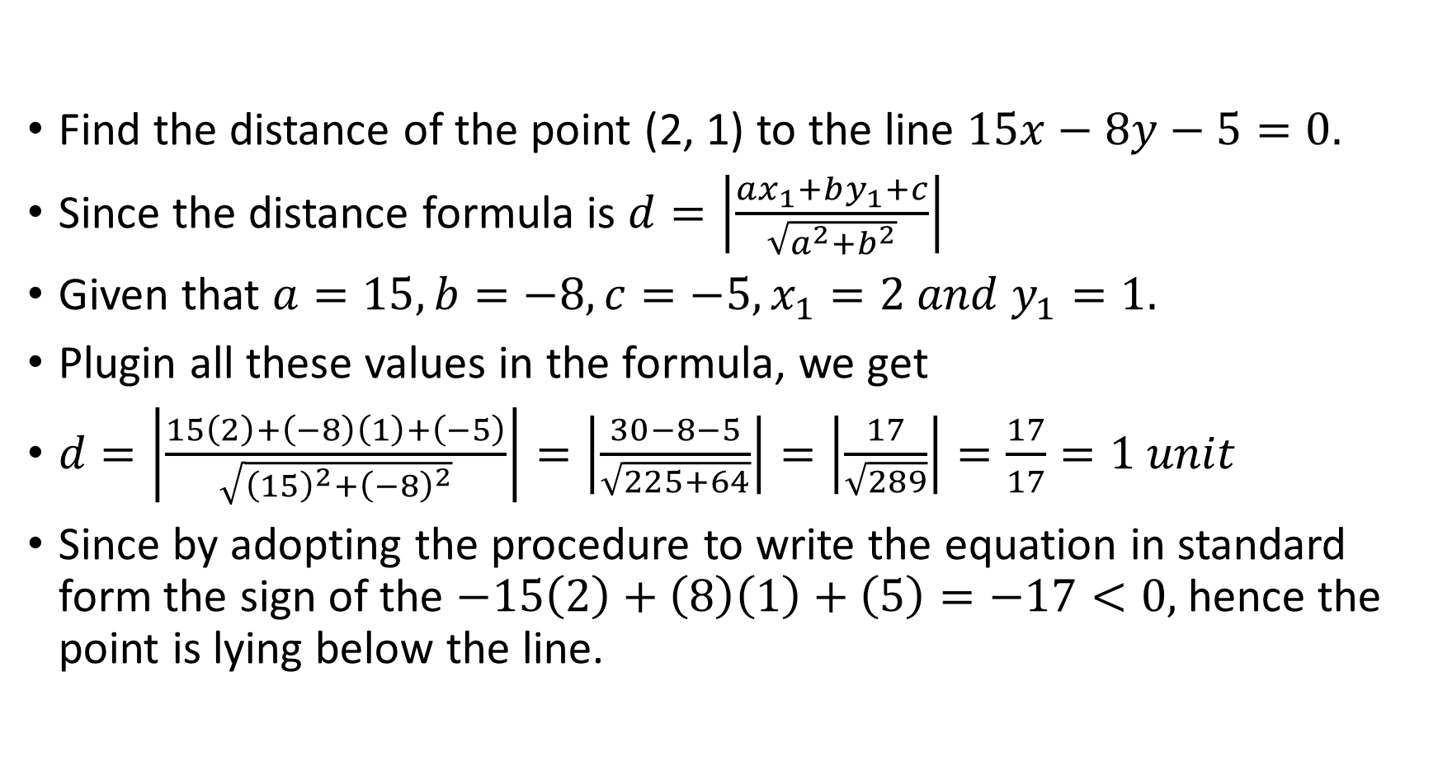
Find the distance of the point (2, 1) to the line $15x−8y−5=0.$
Since the distance formula is $d=\left|\frac{ax_{1}+by_{1}+c}{\sqrt{a^{2}+b^{2}}}\right|$
Given that $a=15, b=−8, c=−5, x_{1}=2 and y_{1}=1.$
Plugin all these values in the formula, we get
$d=\left|\frac{15\left(2\right)+\left(−8\right)\left(1\right)+\left(−5\right)}{\sqrt{{\left(15\right)}^{2}+{\left(−8\right)}^{2}}}\right|=\left|\frac{30−8−5}{\sqrt{225+64}}\right|=\left|\frac{17}{\sqrt{289}}\right|=\frac{17}{17}=1 unit$
Since by adopting the procedure to write the equation in standard form the sign of the $−15\left(2\right)+\left(8\right)\left(1\right)+\left(5\right)=−17<0,$ hence the point is lying below the line.

Slide 5
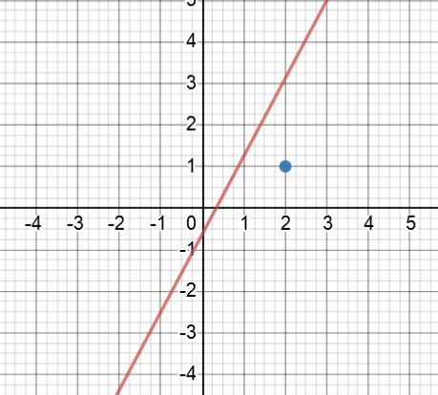
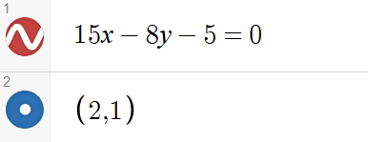


Slide 6
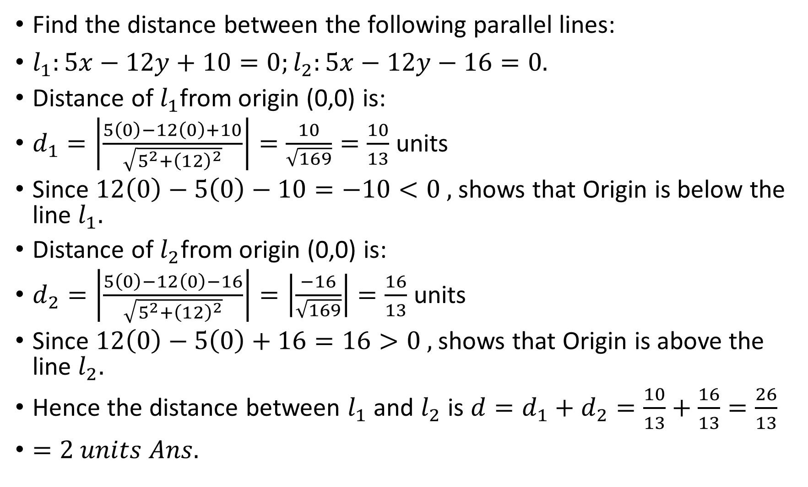
Find the distance between the following parallel lines:
$l_{1}:5x−12y+10=0;l_{2}:5x−12y−16=0.$
Distance of $l_{1}$from origin (0,0) is:
$d_{1}=\left|\frac{5\left(0\right)−12\left(0\right)+10}{\sqrt{5^{2}+{\left(12\right)}^{2}}}\right|=\frac{10}{\sqrt{169}}=\frac{10}{13}$ units
Since $12\left(0\right)−5\left(0\right)−10=−10<0 ,$ shows that Origin is below the line $l_{1}.$
Distance of $l_{2}$from origin (0,0) is:
$d_{2}=\left|\frac{5\left(0\right)−12\left(0\right)−16}{\sqrt{5^{2}+{\left(12\right)}^{2}}}\right|=\left|\frac{−16}{\sqrt{169}}\right|=\frac{16}{13}$ units
Since $12\left(0\right)−5\left(0\right)+16=16>0 ,$ shows that Origin is above the line $l_{2}.$
Hence the distance between $l_{1}$ and $l_{2}$ is $d=d_{1}+d_{2}=\frac{10}{13}+\frac{16}{13}=\frac{26}{13}$
$=2 units Ans.$

Slide 7
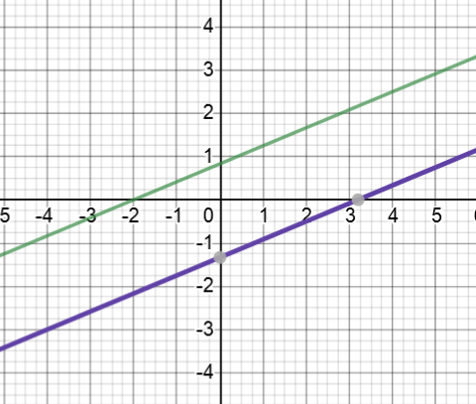
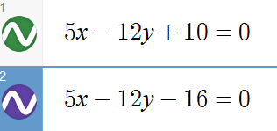


$$d_{1}$$
$$d_{2}$$

Slide 8
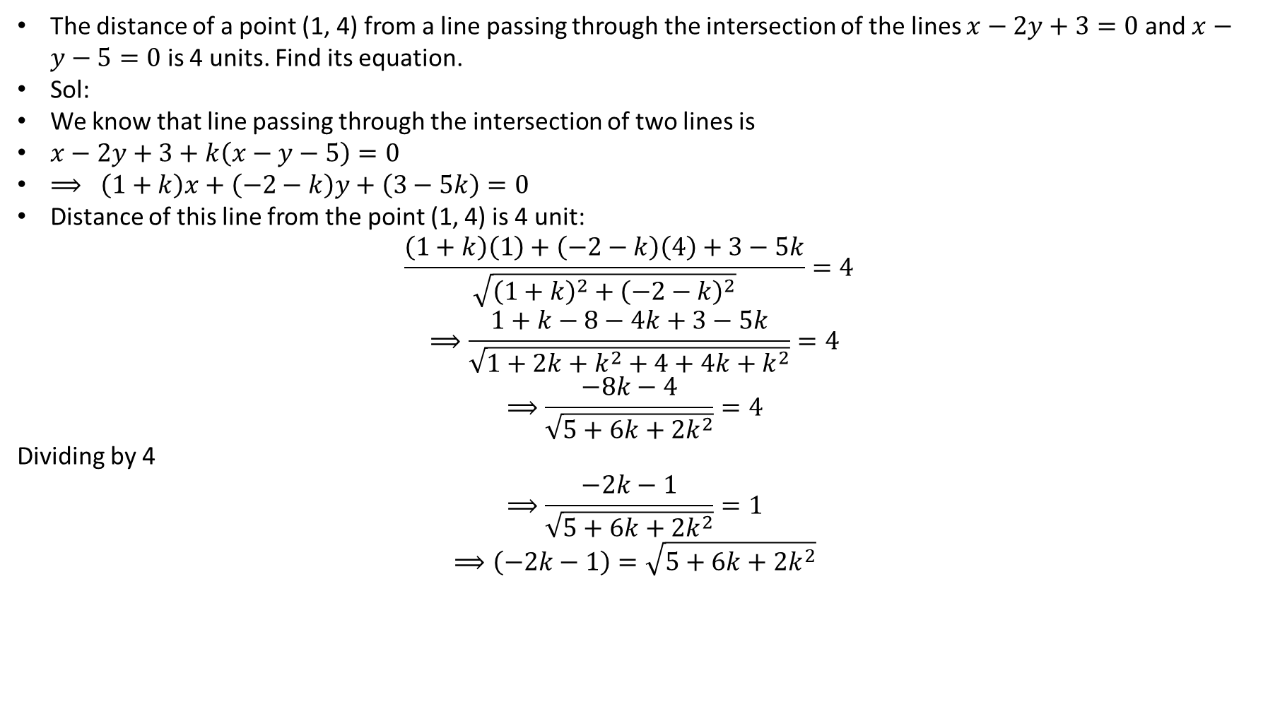
The distance of a point (1, 4) from a line passing through the intersection of the lines $x−2y+3=0$ and $x−y−5=0$ is 4 units. Find its equation.
Sol:
We know that line passing through the intersection of two lines is
$x−2y+3+k\left(x−y−5\right)=0$
$⟹ \left(1+k\right)x+\left(−2−k\right)y+\left(3−5k\right)=0$
Distance of this line from the point (1, 4) is 4 unit:
$$\frac{\left(1+k\right)\left(1\right)+\left(−2−k\right)\left(4\right)+3−5k}{\sqrt{{\left(1+k\right)}^{2}+{\left(−2−k\right)}^{2}}}=4$$
$$⟹\frac{1+k−8−4k+3−5k}{\sqrt{1+2k+k^{2}+4+4k+k^{2}}}=4$$
$$⟹\frac{−8k−4}{\sqrt{5+6k+{2k}^{2}}}=4$$
Dividing by 4
$$⟹\frac{−2k−1}{\sqrt{5+6k+{2k}^{2}}}=1$$
$$⟹\left(−2k−1\right)=\sqrt{5+6k+2k^{2}}$$

Slide 9
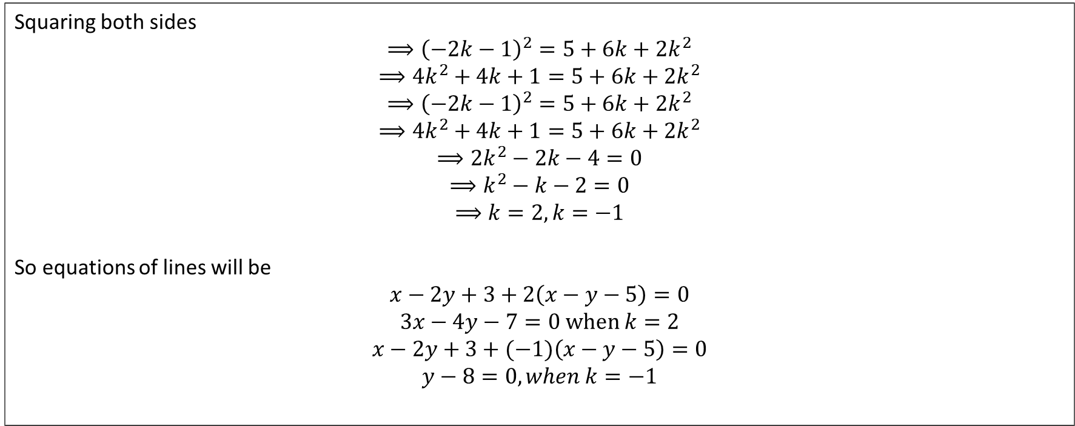
Squaring both sides
$$⟹{\left(−2k−1\right)}^{2}=5+6k+2k^{2}$$
$$⟹4k^{2}+4k+1=5+6k+2k^{2}$$
$$⟹{\left(−2k−1\right)}^{2}=5+6k+2k^{2}$$
$$⟹4k^{2}+4k+1=5+6k+2k^{2}$$
$$⟹{2k}^{2}−2k−4=0$$
$$⟹k^{2}−k−2=0$$
$$⟹k=2, k=−1$$
So equations of lines will be
$$x−2y+3+2\left(x−y−5\right)=0$$
$$3x−4y−7=0 when k=2$$
$$x−2y+3+(−1)\left(x−y−5\right)=0$$
$$y−8=0, when k=−1$$

Slide 10
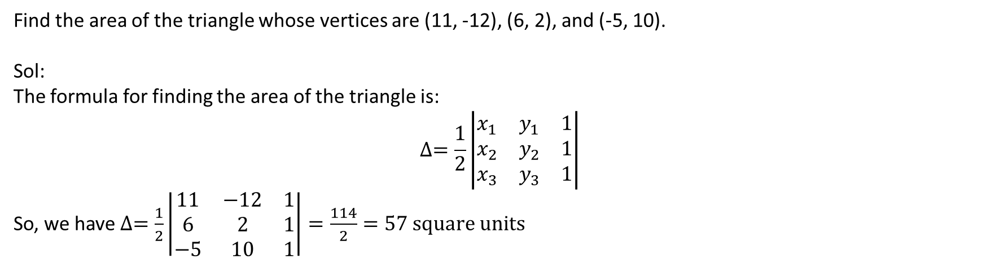
Find the area of the triangle whose vertices are (11, -12), (6, 2), and (-5, 10).
Sol:
The formula for finding the area of the triangle is:
$$∆=\frac{1}{2}\left|\begin{matrix}x_{1} & y_{1} & 1 \\ x_{2} & y_{2} & 1 \\ x_{3} & y_{3} & 1\end{matrix}\right|$$
So, we have $∆=\frac{1}{2}\left|\begin{matrix}11 & −12 & 1 \\ 6 & 2 & 1 \\ −5 & 10 & 1\end{matrix}\right|=\frac{114}{2}=57 square units$

Slide 11
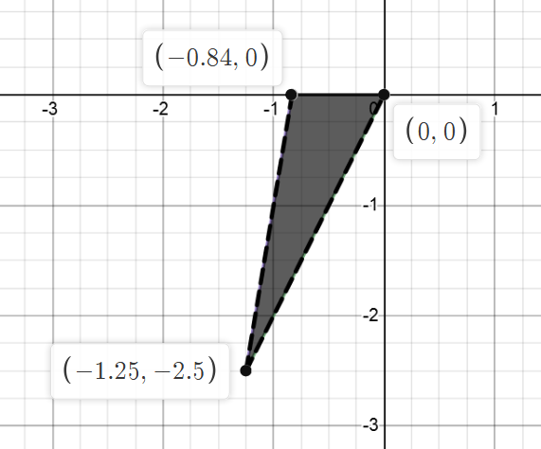
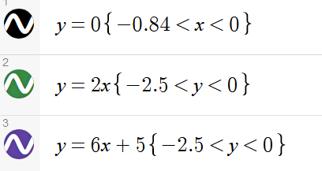
Find area of the triangle formed by the lines:
$$y=0, y=2x, y=6x+5$$

Slide 12
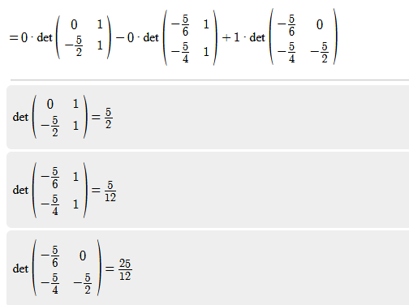
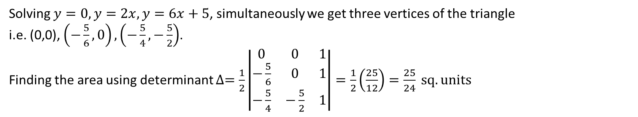

Find area of the triangle formed by the lines:
$$y=0, y=2x, y=6x+5$$
Solving $y=0, y=2x, y=6x+5$, simultaneously we get three vertices of the triangle
i.e. (0,0), $\left(−\frac{5}{6},0\right), \left(−\frac{5}{4},−\frac{5}{2}\right)$.
Finding the area using determinant $∆=\frac{1}{2}\left|\begin{matrix}0 & 0 & 1 \\ −\frac{5}{6} & 0 & 1 \\ −\frac{5}{4} & −\frac{5}{2} & 1\end{matrix}\right|=\frac{1}{2}\left(\frac{25}{12}\right)=\frac{25}{24} sq. units$

Slide 13
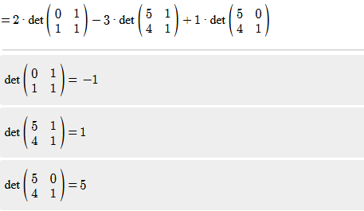
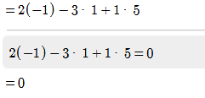
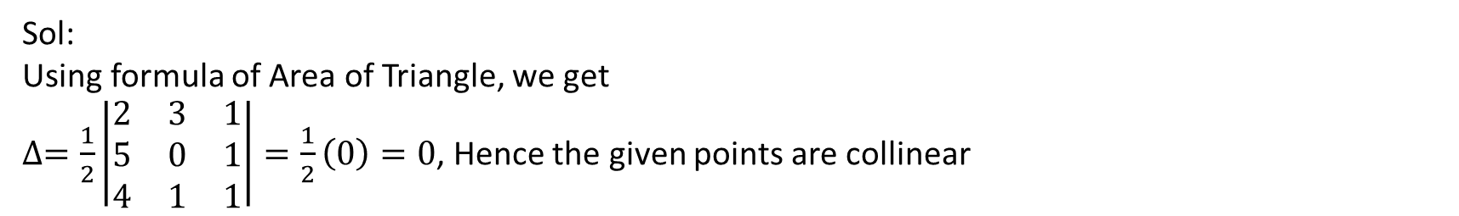
Prove by the method of the area of a triangle, that the following points are collinear: (2, 3), (5, 0) and (4, 1).
Sol:
Using formula of Area of Triangle, we get
$∆=\frac{1}{2}\left|\begin{matrix}2 & 3 & 1 \\ 5 & 0 & 1 \\ 4 & 1 & 1\end{matrix}\right|=\frac{1}{2}\left(0\right)=0$, Hence the given points are collinear

Slide 14
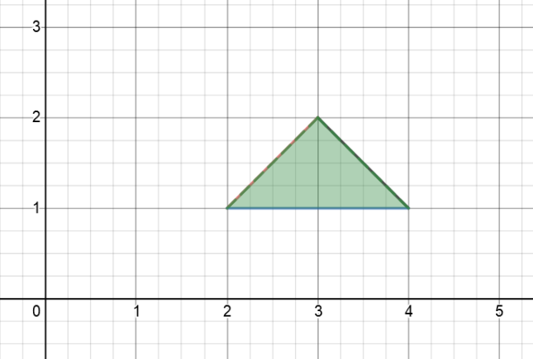
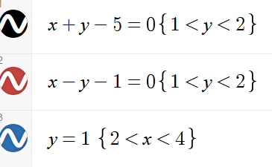

Find the measure of the angles of the triangle, the equations of whose sides are $x+y−5=0, x−y−1=0, y=1$. Also find its area.

Slide 15
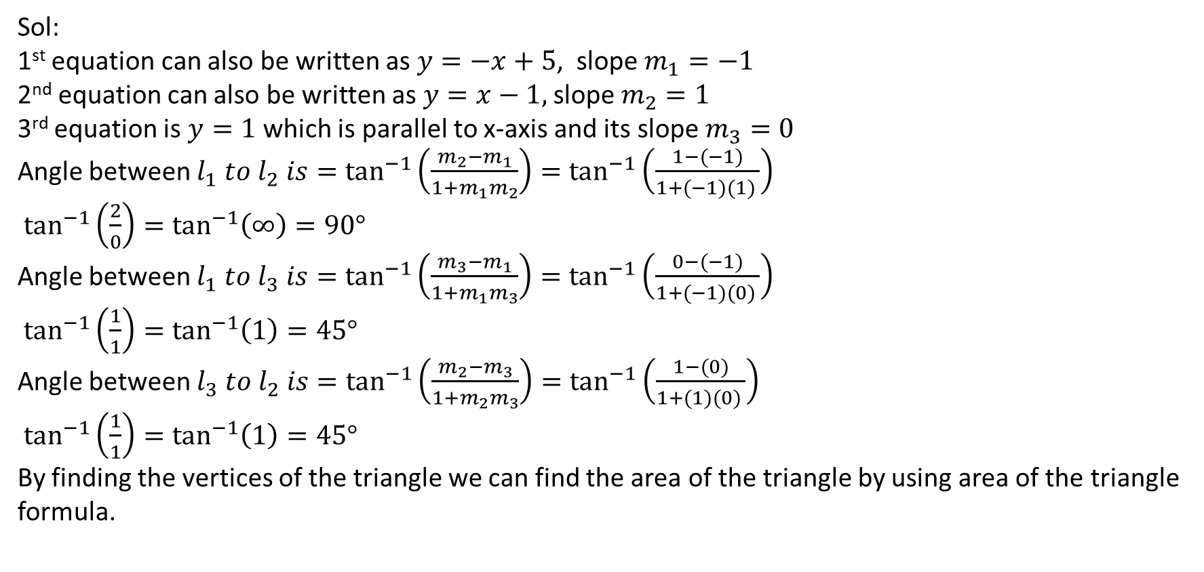
Find the measure of the angles of the triangle, the equations of whose sides are $x+y−5=0, x−y−1=0, y=1$. Also find its area.
Sol:
1st equation can also be written as $y=−x+5$, slope $m_{1}=−1$
2nd equation can also be written as $y=x−1,$ slope $m_{2}=1$
3rd equation is $y=1$ which is parallel to x-axis and its slope $m_{3}=0$
Angle between $l_{1} to l_{2} is=\tan^{−1}\left(\frac{m_{2}−m_{1}}{1+m_{1}m_{2}}\right)=\tan^{−1}\left(\frac{1−(−1)}{1+(−1)(1) }\right)$
$\tan^{−1}\left(\frac{2}{0}\right)=\tan^{−1}\left(∞\right)=90°$
Angle between $l_{1} to l_{3} is=\tan^{−1}\left(\frac{m_{3}−m_{1}}{1+m_{1}m_{3}}\right)=\tan^{−1}\left(\frac{0−(−1)}{1+(−1)(0) }\right)$
$\tan^{−1}\left(\frac{1}{1}\right)=\tan^{−1}\left(1\right)=45°$
Angle between $l_{3} to l_{2} is=\tan^{−1}\left(\frac{m_{2}−m_{3}}{1+m_{2}m_{3}}\right)=\tan^{−1}\left(\frac{1−(0)}{1+(1)(0) }\right)$
$\tan^{−1}\left(\frac{1}{1}\right)=\tan^{−1}\left(1\right)=45°$
By finding the vertices of the triangle we can find the area of the triangle by using area of the triangle formula.

Slide 16
Thank you so much

